Slide 1
Abstract Data Structures
TOPIC 5.0 – ABSTRACT DATA STRUCTURES
TOPIC 5
2D Arrays and Stacks

Slide 2

REVIEW REVIEW REVIEW REVIEW REVIEW REVIEW
THE WARM-UP QUESTION
Write a recursive python function to return the sum of all integer numbers less than or equal to the input variable n

Slide 3
REVIEW REVIEW REVIEW REVIEW REVIEW REVIEW
THE WARM-UP ANSWER
def sum(n):
if n == 0:
return 0
else:
return n + sum(n-1)

Slide 4
Topic 5.1.4 – THINKING RECURSIVELY
‘Arrays’
Recall our previous discussions of lists vs arrays
Lists – variable in length, can hold multiple data types, less efficient
Arrays – fixed length, only one data type, way faster
Both have their upsides and downsides
When talking about lists in this class, I may reference them as arrays, especially in this lesson
We will delve into further detail about what makes a list unique later in this unit

Slide 5
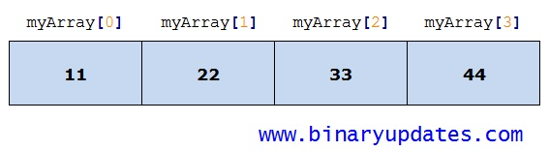
Topic 5.1.4 – THINKING RECURSIVELY
1D Arrays
One dimensional arrays should be thought of as a line of elements
Each element follows the previous element, there’s a sequence

Slide 6
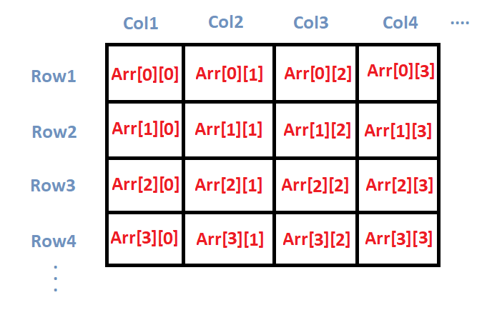
Topic 5.1.4 – THINKING RECURSIVELY
2D Arrays
However, lots of data comes not in a list, but in a grid, or a data table. Data tables need something two dimensional to be adequately represented
You use 2 subscripts to index a 2d array

Slide 7
Topic 5.1.4 – THINKING RECURSIVELY
2D Arrays EXAMPLE
Student | Exam 1 | Exam 2 | Exam 3 | Exam 4 | Exam 5
John | 98 | 68 | 65 | 73 | 67
Joe | 77 | 77 | 88 | 78 | 90
Jorblo | 53 | 63 | 74 | 85 | 72
Jach | 77 | 77 | 68 | 78 | 91
Juan | 88 | 86 | 90 | 56 | 81

Slide 8
Topic 5.1.5 – THINKING RECURSIVELY
2D Arrays EXAMPLE
SCORES =
[[98, 68, 65, 73, 67],
[77,77,88,78,90],
[53,63,74,85,72],
[77,77,68,78,91],
[88,86,90,56,81]]
STUDENT = 0
EXAM = 0
loop STUDENT from 0 to 4
output STUDENT + 1, “student”
AVG = 0
loop EXAM from 0 to 4
AVG = AVG + SCORES[STUDENT][EXAM]
end loop
output AVG / 4
end loop

Slide 9
Topic 5.1.5 – THINKING RECURSIVELY
2D Arrays EXAMPLE
scores =
[[98, 68, 65, 73, 67],
[77,77,88,78,90],
[53,63,74,85,72],
[77,77,68,78,91],
[88,86,90,56,81]]
for i in range(len(scores))
print(i + 1, “student”)
average = 0
for j in range(len(scores[i]))
average = average + scores[i][j]
print(avg/4)

Slide 10
Topic 5.1.4 – THINKING RECURSIVELY
Nested loops
As you can see, our 2D arrays are often manipulated using nested for loops
This is not the only way to access the elements in a 2D array but it’s by far the simplest, so we will continue to use it
Each loop will handle one axis of the array

Slide 11
Topic 5.1.4 – THINKING RECURSIVELY
2D Arrays CONCLUSION
Ultimately 2D arrays are just an array containing other arrays
Or a list containing other lists in Python
IB Pseudocode uses arrays, not lists, so be aware of the differences

Slide 12
Topic 5.1.6 – THINKING RECURSIVELY
Stacks
Stacks are a variant of the list
Not the array, the list
Stacks are variable in length and data type
Most programming languages have a stack that is built on top of their list structure
Python does not, but it’s list can be used as a stack
Stacks are a concept first and a variable type second
Not all programming languages have stacks built-in
Some require you to create your own out of a list

Slide 13
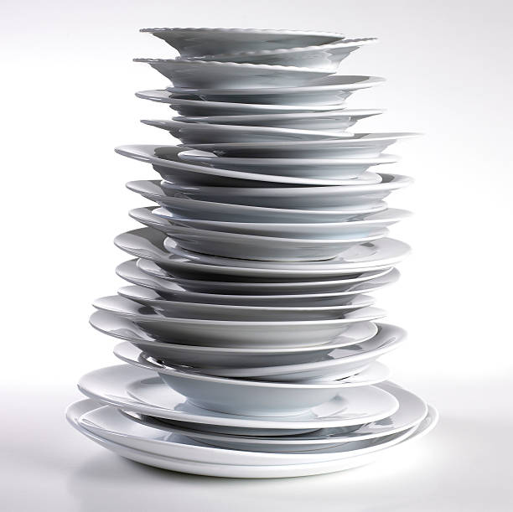
Topic 5.1.6 – THINKING RECURSIVELY
Stack STructure
Stacks are LIFO
This is short for last in – first out
It means that the most recently added item to the stack is the only one that can be taken out of the stack
Think of this as a stack of plates, you can only remove the plate on the top of the stack
This is where we derive the name ‘stack’

Slide 14
Topic 5.1.7 – THINKING RECURSIVELY
Stack METHODS
push() – push an item onto the stack
In Python, this is append()
pop() – remove the item most recently added to the stack, at the ‘top’
isEmpty() – returns true or false based on if the stack is empty
Not built into Python, check if length is 0
Yep, these are all you need to work with a stack

Slide 15
Topic 5.1.7 – THINKING RECURSIVELY
Stack METHODS
stack.push(5)
stack.append(5)
Stack
5

Slide 16
Topic 5.1.7 – THINKING RECURSIVELY
Stack METHODS
Stack
3
5
stack.push(3)
stack.append(3)

Slide 17
Topic 5.1.7 – THINKING RECURSIVELY
Stack METHODS
Stack
3
5
stack.pop()
stack.pop()

Slide 18
Topic 5.1.7 – THINKING RECURSIVELY
Stack METHODS
stack.push(6)
stack.append(6)
stack.push(10)
stack.append(10)
stack.push(-12)
stack.append(-12)
stack.push(3)
stack.append(3)
Stack
3
-12
10
6
5

Slide 19
Topic 5.1.7 – THINKING RECURSIVELY
Stack METHODS
output stack.pop() + stack.pop()
print stack.pop() + stack.pop()
This code will print -9
Stack
10
6
5

Slide 20
Topic 5.1.6 – THINKING RECURSIVELY
Stack USES
What are some applications of a stack in programs that you might use personally?

Slide 21
Topic 5.1.6 – THINKING RECURSIVELY
Stack USES
Web browsers use a stack to handle the back button
Recursive methods are handled on a stack, when the method is completed, it is popped
Undoing in programs, each action could be an item on a stack
Programming languages balancing parenthesis in statements
print(len(arr))

Slide 22
Topic 5.1.7 – THINKING RECURSIVELY
Stack IN PSEUCDOCODE
STACK = new Stack()
STACK.push(“item”)
output STACK.pop()
if STACK.isEmpty() then
…

Slide 23
Topic 5.1.7 – THINKING RECURSIVELY
Stack IN PYTHON
Stacks don’t formally exist in Python
If you’d like to use a stack, ensure that you adhere to using only .append(), .pop(), and .isEmpty()

Slide 24
Topic 5.1.7 – THINKING RECURSIVELY
PRACTICE
Using Python, write a program that will perform the following operations in order:
Push 32
Pop
Push 13
Push 42
Push 35
Pop elements in a loop until no elements exist
Push 17
Push 12
Pop twice and add the elements together

Slide 25
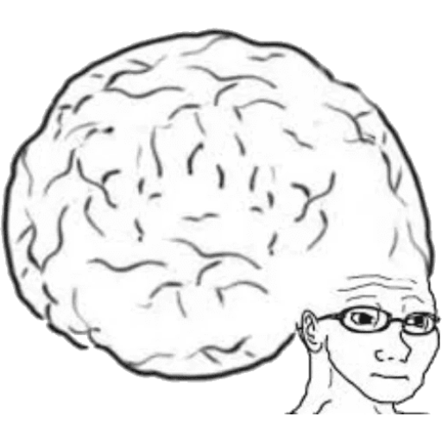
Topic 5.1 – THINKING RECURSIVELY
VOCAB TO REMEMBER
Stack
2D Array
Nested Loop
Push
Pop

